Slide 1
Predicting whether a customer will CHURN Syriatel.
A TELECOMMUNICATIONS COMPANY

Slide 2
Business Understanding
Serving millions of customers across the country, it has played a significant role in:
expanding and modernizing telecommunications infrastructure
contributing to the country's connectivity and economic development.

Slide 3
cont.
The field faces complex challenges due to a number of vibrant competitive service providers, becoming difficult to retain existing customers.
The cost of acquiring new customers is much higher than that of retaining the existing customers

Slide 4
Data Understanding
483 disloyal customers have churned the services.
There are 51 unique states represented.
The churn rate was observed to be at 14.49%.

Slide 5
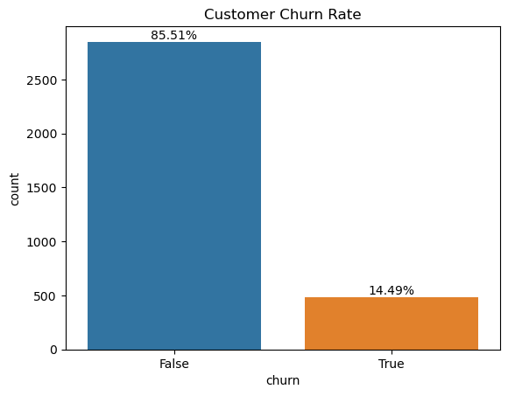
Cont.

Slide 6
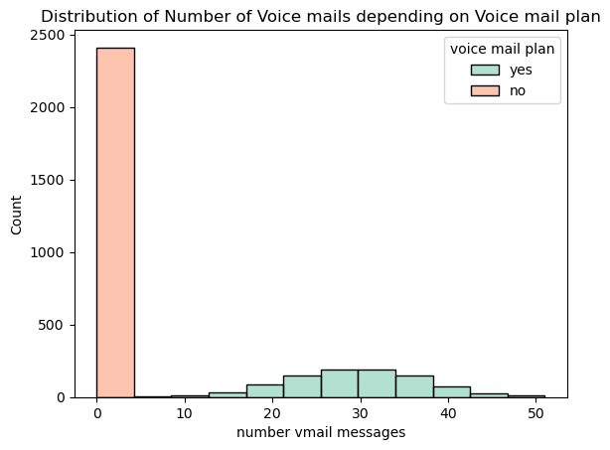
Cont.

Slide 7
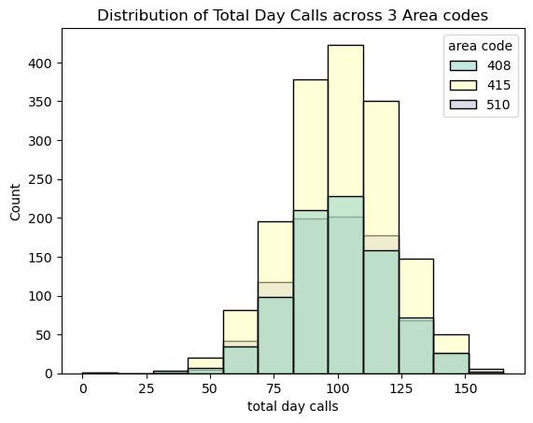
Cont.

Slide 8
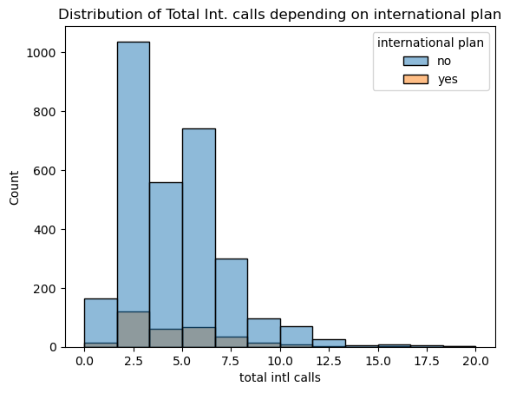
Cont.

Slide 9
Modelling
The first model, Logistic regression, which was the baseline model gave an accuracy of 85%.
The second model, Logistic Regression but with additional hyperparameters, gave an accuracy of 86% .

Slide 10
Cont.
XGBoost
Training accuracy : 95.34%
Test accuracy : 95.35%
Gradient Boosting
Training accuracy : 95.42%
Test accuracy : 95.05%

Slide 11
Model Evaluation
Based on the metrics, Gradient Boosting and XGBoost not only performed well on training data but also generalized effectively to unseen test data.
Deploying Gradient Boosting and XGBoost models for their churn prediction system would be the most effective strategy.

Slide 12
Recommendations
By leveraging the high-performing models, SyriaTel can gain valuable insights into customer behavior and implement targeted retention strategies to reduce churn.
Continuous monitoring, model updates and integration with CRM systems will enhance the effectiveness of these efforts, contributing to increased customer retention and growth.

Slide 13
Next Steps
SyriaTel can implement the following customer retention strategies:
Proactive Customer Support
Personalized Offers and Discounts to enhance their satisfaction and loyalty.
Improved Service Plans.

Slide 14
Thank you!

